Slide 1



SenSyn - Senior Synergy: Empowering Lifelong Learning and Healthy living through Community Events

Slide 2

MODULE 8: LIFELONG LEARNING AND VOLUNTEERING
Learning as a way of life - Asking and Encouraging

Slide 3


LIFELONG LEARNING

Slide 4


LIFELONG LEARNING
In a fast-changing and increasingly unpredictable world, learning and openness to new skills and knowledge are more important than ever.

Slide 5




WHAT IS LIFELONG LEARNING?
Lifelong learning is a continuous process of acquiring knowledge and skills throughout life.
It means learning and growing in different areas, whatever our age.
1.formal education (courses, lectures),
2.non-formal education (workshops, hobbies), and
3.informal learning (learning from everyday experiences).

Slide 6


OPPORTUNITIES TO GET INVOLVED IN EDUCATION
Formal education:
Courses and lectures: learn new skills through courses in different areas such as computer literacy, languages, arts, health and well-being.
Certificates and diplomas: For those who want to formally validate their knowledge, there are programs leading to certificates or diplomas.
Non-formal education:
Workshops and hobbies: take part in various workshops such as cooking classes, art workshops, gardening, handicrafts, music.
Group activities: Join groups where you can share and develop your interests, e.g. book clubs, hiking groups, chess families.
Casual learning:
Daily activities: Learn from everyday experiences such as travelling, volunteering, socializing with grandchildren, using new technologies.
Online resources: Make use of online resources for self-learning, such as online courses, educational videos, e-books.

Slide 7
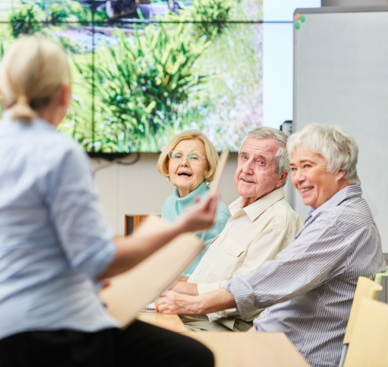





Slide 8

LIFELONG LEARNING
Lifelong learning competence is the continuous acquisition and development of knowledge, skills and competences.
It refers to:
-satisfying one's own learning needs,
-seeking opportunities for education, training and new experiences,
-willingness to learn at work and outside the workplace,
-recognising the need to learn in order to cope successfully with constant change,
-investing effort and time in learning, learning how to learn and different learning techniques,
-actively seeking feedback from others,-learning and monitoring one's own progress.

Slide 9
THE BENEFITS OF LIFELONG LEARNING
Improving cognitive abilities: regular learning and mental activities help to keep the brain active and healthy.
Social inclusion: meetings and training provide opportunities to make new friends and reduce feelings of loneliness.
Personal growth: acquiring new skills and knowledge boosts self-confidence and personal satisfaction.
Physical health: some forms of learning involve physical activity, which has a positive impact on health and vitality.
Increasing quality of life: Spending time actively learning contributes to a fuller and more satisfying life.

Slide 10
Learning is a lifelong journey that must continue into adulthood and beyond
The participation of adults in lifelong learning in Slovenia (11.2%) is higher than the EU average (10.8%). However, the OECD PIAAC survey of adult skills shows that more than 400,000 adults in Slovenia have only the lowest levels of literacy and numeracy skills.
This suggests that this is a wider phenomenon that requires a holistic approach. Knowledge follows us throughout our lives, and so should learning. Slovenia boasts a wide range of organized education and learning resources of all kinds for all generations, and opportunities for learning are increasing.
https://www.gov.si/novice/2021-01-07-ucenje-kot-nacin-zivljenja-sprasujemo-in-spodbujamo/

Slide 11
Adult learning helps us keep pace with the changing world
With the rapid development of technology, the world is changing fast.
The way we work, communicate, travel and even think has changed forever. To stay productive and independent, we need to keep up with these changes, and adult learning can play a key role.
Through adult education courses, we can keep up with global advances and acquire skills that were not available when we were in school.
"Adult learning: the key to success in a fast-changing world."

Slide 12
Adult learning helps us keep pace with changes in ourselves
Life brings constant changes in our minds, bodies and circumstances. This can mean new interests, changes in finances or health. It is important to be prepared to adapt to new situations.
A career change or the need to earn extra money are often part of these adjustments.
Adult education courses allow you to keep your knowledge and skills up to date, giving you the opportunity to change your career or adapt to new challenges at any time .
„Always up-to-date with adult learning.“

Slide 13
Adult education is essential for retraining
"Adult learning: the key to new career paths and flexibility".
Rapid advances in technology mean that many jobs are disappearing, causing hardship for many workers as modern technologies replace them.
Adult learning offers solutions through fast and effective retraining, which will benefit many in the future.
Adult courses are also crucial for those who want to change their career path.

Slide 14
Learning keeps your mind active
Studies show that keeping an active mind is good for your health, as people who use their brains regularly maintain better memory, sharper reactions and better attention even in old age.
Simple ways to keep an active mind include learning a new language, mastering a new skill or completing crossword puzzles, which have mental benefits and reduce the risk of dementia.
"Active mind, healthy life: learn to stay sharp".

Slide 15
Participation in education also increases social inclusion
People who are open to new knowledge are often more socially engaged, which helps them stay active, mentally stimulated and connected to others.
Adult courses not only bring new skills, but also opportunities to build healthy and strong friendships, which boosts self-confidence and performance in all areas.
"Adult education: the path to new skills, friendships and success."

Slide 16
FACTORS AFFECTING THE PARTICIPATION IN EDUCATION

Slide 17
Economic factors
Costs of Education:
High costs reduce the willingness of all adult groups to participate in education.
Education is often perceived as an investment, but this perspective is influenced by individual characteristics like gender, age, social status, and education level.
Time Constraints and Costs:
Adults frequently cite lack of time and education costs as major barriers to participation.
To fully understand the impact of these factors, it is essential to analyze the specific characteristics, needs, and barriers faced by the participants.
Individual Characteristics:
Decisions about education are more influenced by personal traits rather than viewing education as an investment.
Social Context:
Past research has focused more on macro-level social contexts, such as socioeconomic status, ethnicity, and gender, which significantly affect learning opportunities and decisions.

Slide 18
Sociological factors
Degree of education attained-Educational experience in youth
Previous participation in adult education
The adult's social roles, both work and leisure, are an important determinant of older adults' participation in education
Older adults who have been active in learning throughout their life cycle will continue to be relatively active in later life, but the purpose, aim and intensity of their activity changes.
Participation in adult education - irrespective of other factors - declines with age.

Slide 19
Psychological factors
Barriers to education:
1.Dispositional:
related to the psychological and ﬁscal characteristics of individuals that negatively impact on the individual's decision to pursue education.
These include:
self-image,
self-consciousness,
degree of aspiration,
attitudes,
learning abilities,
attitude to education.
It may be fear of failure, tiredness, feeling that they are too old. These barriers are often underestimated, as adults are reluctant to cite them as reasons for their non-participation (only 5-15% of adults cite them), and they are also linked to certain stereotypes (e.g. about learning ability in old age).

Slide 20
2. Situational barriers:
Lack of money (e.g. to buy study materials, pay tuition fees, transport to education, etc.),
time (more common for younger adults, more educated adults and those with higher incomes, but also very present for older adults),
the influence of family and friends (when these influences are discouraging),
distance from the educational organization and some other factors.
(Rubenson and Gongli 1997). McGivney (2001: 21) and Sargant et al. (2000) find that low income and place of residence have an extremely important influence on adult participation in education. An increase in leisure time alone does not increase people's educational attainment; the more active people are, the greater their need for new knowledge and the more time they are willing to spend on it.

Slide 21
3.Institutional barriers:
-scheduling difficulties,
-inadequate programs (offer),
-inadequate content,
-enrolment conditions,
-lack of information,
-inadequate teachers, etc.
Sargant et al (1997: 65) state that in the UK, disinterest in learning increases sharply with age; almost half of the over-75s consider themselves too old, too ill or too unfit to learn. The characteristics of educational programs are an important de-identifier of participation in education by adults and older adults in particular; educational provision is also increasingly responsive to market needs and targeted at adults with clear aspirations. Motivation for education is one of the most characteristic indicators of participation.
Source: Lifelong learning and education for older adults. January 2009 Publisher: Ljubljana: Pedagoški institut.ISBN: 978-961-6086-95-0LIFELONG LEARNING - EDUCATION OF OLDER ADULTS Dr Sonja Kump Dr Sabina Jelenc Krašovec SCIENTIFIC REPORTS OF THE PEDAGOGICAL INSTITUTE

Slide 22
What kind of education promotes social inclusion for older adults?
Education in old age depends on education throughout the life cycle.
Educational gerontology emphasizes the importance of education in reducing the marginalization of older adults, which is influenced by economic, social, political and cultural factors.

Slide 23
Education offer in Slovenia
In Slovenia, education exclusively for older adults began in 1984, when the first experimental education program for older people was launched.
In 1986, volunteers within the Andragogical Society and on the initiative of Prof. Dr. Ana Krajnc laid the foundations for today's University for the Third Age, which now operates as an independent association (Findeisen 1999; Krajnc 1992; 1999).The University of the Third Age is by its nature non-profit-making. It is based on voluntary work, participation and contribution. The students, tutors and staff of the university share their knowledge, experience, culture and insights with each other and contribute to the creative work of their study group and the university as a whole to the best of their abilities.
The University is open to adults in their later years and to long-term unemployed older people, irrespective of their age, level of formal education, political, ethnic or religious affiliation.
http://www.univerzazatretjeobd-drustvo.si/Porocilo%20U3%202007.pdf

Slide 24

Slovenian Third Age University http://www.univerzazatretjeobd-drustvo.si/Porocilo%20U3%202007.pdf
36 Universities across 34 towns and cities in Slovenia.
17,000+ Older Adults participating in educational programs.

Slide 25
Growing Interest and Provision
Year-by-year growth in the number of learning groups and participants.
Strong Interest: Reflects both the desire for education among older adults and the current lack of sufficient educational opportunities.

Slide 26

Subjects Offered http://www.univerzaza-tretjeobd-drustvo.si/Porocilo%20U3%202007.pdf
Art History & Archaeology
Musical Art
History
Literature
Psychology
Astronomy
Calligraphy
Computer Science
Foreign Languages
Other interesting subjects

Slide 27
The following activities are among the study activities of the University of Ljubljana for the Third Age in Ljubljana:
-training of older adults for self-employment,
-training for voluntary work in non-governmental organizations,
-education of older adults and the public for changing the position of older adults in society and for active coexistence with other generations,
-advising older adults to live and deal with life issues,
-training mentors of older adults, etc.

Slide 28

Students of the University of the Third Age can take part in various volunteering programs organized by the University itself or in cooperation with cultural, educational, health and humanitarian institutions, such as museums, libraries, schools, kindergartens, hospitals, charities and retirement homes.
Voluntary work gives older people the opportunity to learn, help others, enjoy socializing and grow as individuals.

Slide 29
Additional new educational opportunities in Slovenia after 1990
STUDY CIRCLES
PRINCIPLES: Public Universties, Universities for the Third Age, public libraries, other organizations.
Common themes: folk traditions, customs and traditions no longer known to young people.
PURPOSE: by passing on knowledge and experience from the older to the younger generation, we also promote intergenerational cooperation and help.

Slide 30
Some other organizations and programs that are not exclusively educational are also important for the education of older adults:
Associations,
Clubs and
Other voluntary organizations (e.g. in pensioners' associations)
Various associations have many educational activities as part of their core activities and encourage their members to engage in lifelong learning in various ways. Particularly in associations of people with chronic illnesses, secondary lifelong rehabilitation is key to maintaining health and quality of life and is an important source of social activities for members. In many of these associations, older adults make up a large proportion of the total membership.
https://www.researchgate.net/publication/280741770_Vsezivljenjsko_ucenje_in_izobrazevanje_starejsh_odraslih

Slide 31
Intergenerational programmes
Complement various forms of community education and voluntary work and reduce social exclusion of older adults
Through intergenerational groups, older adults meet their non-material social needs, the middle generation prepares for their own quality old age, and young people discover the wisdom of living with older adults.
In intergenerational programs, older adults can become an important support for others, encouraging others in their learning, personal development and active social life.

Slide 32
How to join such programs?
Lifelong learning is the key to a richer, fuller and more satisfying life. Join us on this journey and discover new opportunities for growth and development, whatever your age. Together we can achieve more and embark on an unforgettable journey through life!
Website: Visit our website for details of the program and current training courses.
Information: For more information, please visit the websites of the institutions or visit their premises in person.
Information days: Attend information days to find out more about the program and how to get involved.
Registration: You can register by phone, email or in person at the individual training providers.
Keep informed: Follow local announcements, bulletin boards and social networks for current events and programs.
There are many opportunities for lifelong learning in Ptuj and Murska Sobota, whatever your interests and prior knowledge.

Slide 33

Integration opportunities for you in Ptuj
Public University of Ptuj
The Public University of Ptuj offers various educational programs for older people.
Computer courses: basic and advanced use of computers, smartphones and the internet.
Language courses: learning foreign languages such as English, German, Italian.
Art workshops: painting, sculpting, creating handicrafts.
Health workshops: Lectures and workshops on healthy lifestyle, nutrition, exercise.
2. University for the Third Age Ptuj
The University of the Third Age offers educational programs tailored to older people:
Lectures: various topics such as history, culture, natural sciences.
Workshops and courses: art, language, computer.
Social activities: organization of excursions, cultural events, meetings.

Slide 34

3. Ivan Potrč Library Ptuj
The Ivan Potrč Library Ptuj offers many opportunities for lifelong learning:
Book Club: regular meetings for book lovers to discuss the books they have read.
Educational programs: lectures, workshops and seminars on various topics..
4. Kulturna društva in centri
Kulturno društvo Ptuj: Organization of cultural events, workshops and courses.
Youth Centre Ptuj: Intergenerational activities where older people can interact with younger generations.
5. Municipality of Ptuj
The Municipality of Ptuj regularly organizes various projects and programs for older people:
Project "Active Ageing": includes training, workshops, lectures and social activities for senior citizens.

Slide 35
Integration opportunities for you in Murska Sobota
University for Adult Education of Murska Sobota
University for Adult Education of Murska Sobota offers various educational programs for older people.
Computer courses: basic and advanced use of computers, smartphones and the internet.
Language courses: learning foreign languages such as English, German, Italian, French, Spanish, Russian.
Art workshops: calligraphy, study circles (manual skills, cooking).
Health workshops: lectures and workshops on healthy lifestyle, nutrition and exercise.
2. University for the Third Age at University for Adult Education of Murska Sobota
The University of the Third Age offers educational programs tailored to older people:
Lectures: various topics such as history, culture, natural sciences.
Workshops and courses: art, language, computer.
Social activities: organization of excursions, cultural events, meetings.

Slide 36
3. Murska Sobota Regional and Study Library (PIŠK)
Educational programmes: lectures on various topics.
4. Mensana Intergenerational Centre
Intergenerational activities: programmes involving cooperation between young and old, promoting dialogue and sharing knowledge and experience.
5. Municipality of Murska Sobota
The Municipality of Murska Sobota offers various programmes and activities for senior citizens that promote social interaction, active leisure and healthy lifestyles.

Slide 37
Integration opportunities for you in Varaždin
1. Pučko otvoreno učilište Varaždin - the institution offers language programs, ICT programs, creative workshops for seniors and projects especially tailored for elderly population.
2. Udruga umirovljenika Grada Varaždina - recreative and educational activities, weekly gatherings in the neighborhood locations.
3. Udruga Futur egzaktni - educational activities and weekly exercises.
4. Klub starijih osoba Varaždin - dance, creative workshops and exercises.

Slide 38
Integration opportunities for you in Samobor
1. Pučko otvoreno učilište Samobor - the institution offers public lectures on various topics, digital literacy for seniors, creative workshops for seniors, program aimed at the empowerment and socialization of the elderly and projects especially tailored for elderly population.
2. Udruga umirovljenika Grada Samobora - recreative and educational activities, cooking workshops, medical exercise, dancing, monthly gatherings, excursions and summer vacation.
3. Gradsko društvo Crvenog križa Samobor - DIY workshops, social gatherings featuring various current and traditional topics, board games and quizzes, nordic walking and projects especially tailored for elderly population.
4. Samoborske kralušice - workshops on crafting the traditional Samoborski kraluš, whose craftsmanship is protected as intangible cultural heritage of Croatia and items related to local ethnographic traditions.
5. Društvo za športsku rekreaciju “Šport za sve” Samobor - Corrective gymnastics for the elderly.

Slide 39
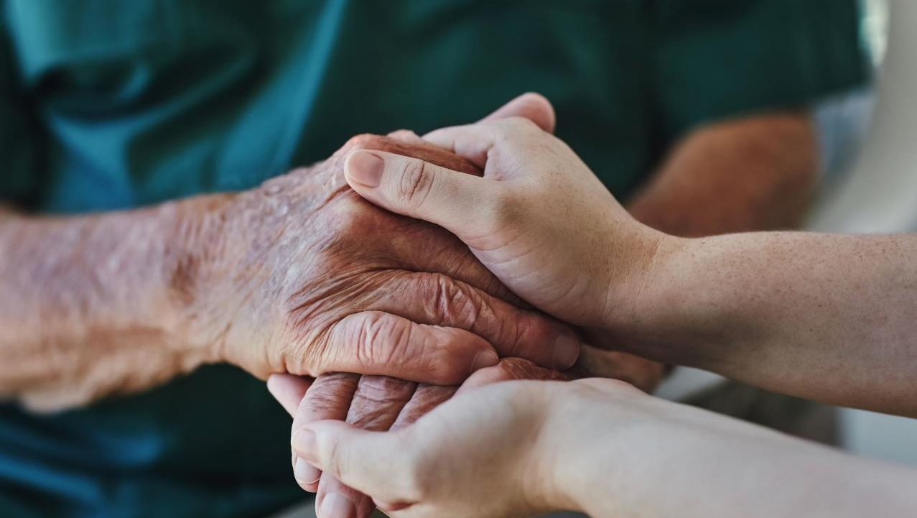
VOLUNTEERING

Slide 40
WHAT IS VOLUNTEERING?
Voluntary work is work that an individual does of his or her own free will and without expectation of material gain for him or herself, for the benefit of others or for the general good.

Slide 41
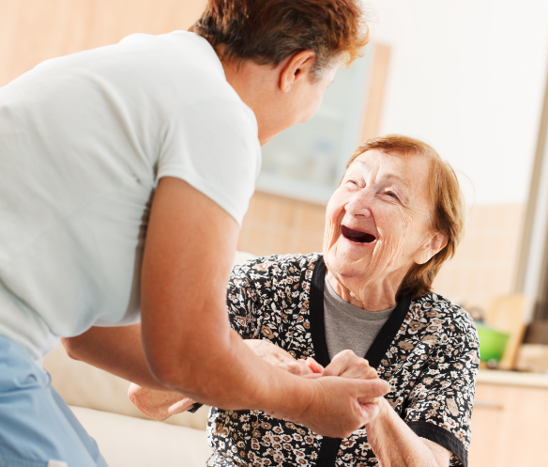
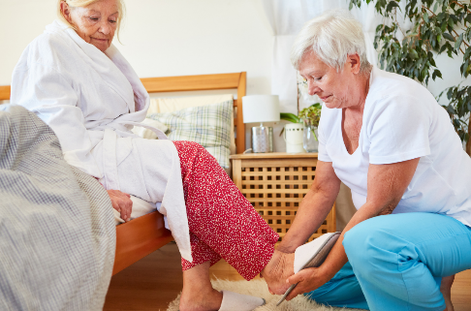
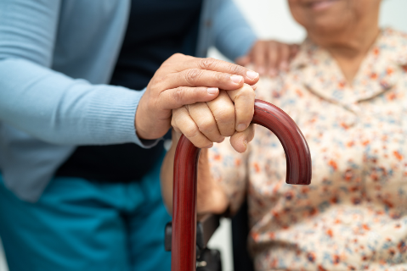

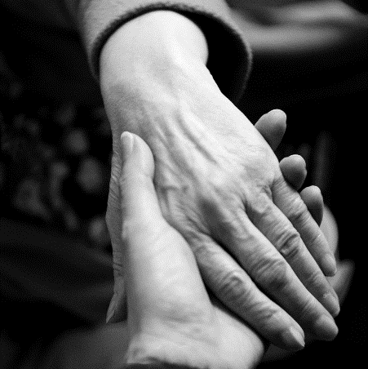
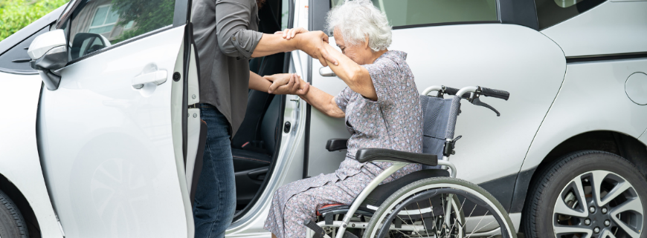

Slide 42

Volunteering can be done in an informal way, which includes all forms of unorganized help, and in an organized way, through voluntary organizations and organizations with a volunteering program.

Slide 43

WHY VOLUNTEER?
has a purpose and a meaning,
is enjoyable-enables social contact,
develops skills and
achieve competence,
increase self-confidence-grow self-esteem
allows you to contribute to society

Slide 44

Reasons to volunteer
We want to do good,
We want to indulge our interests and put them into practice,
Want to learn new things and skills.
For many, volunteering is not a rational choice, it is more a spur of the moment or a coincidence.
More than 30% of volunteers join the volunteering ranks at the encouragement of a relative or friend. This is important to remember when planning volunteer recruitment.

Slide 45
Volunteering is important for the community because:
improves the quality of life in society;
defends the interests of individuals and groups who are at risk, disadvantaged, marginalised, excluded;
is one of the primary ways in which civil society responds to its needs and creates opportunities for citizens to be active in society;
has great significance for development and for the future. It contributes to the development of existing systems, to the development of values of solidarity, to the social and other progress of society.

Slide 46

Benefits of volunteering
Meeting new people and creating community
Being part of a team with a common goal makes it easier to form bonds with strangers. Volunteering is about helping others, which in turn means you will create meaningful relationships with others and increase your social interactions. In addition, creating a community where you all work together towards common goals will boost your sense of belonging and mission.
New skills
Volunteering gives you the opportunity to bring new people into your circle of acquaintances. This experience can broaden your understanding of others who are different from you. Learning about cultures and ways of life different from your upbringing will increase your social flexibility and broaden your world view. You will also develop important social skills such as empathy and teamwork.

Slide 47

http://talentiran.si/index.php?option=com_content&view=article&id=3033&catid=150&Itemid=671
Meaning, happiness and physical benefits
There is no doubt that volunteering offers a sense of achievement, a sense of mission and a sense of happiness. In addition to the happiness itself, volunteering brings many physical benefits. Spending meaningful time with others can reduce stress, which means many physical health benefits - better sleep, fewer illnesses and even heart disease prevention. It makes sense that when we give our attention to others, we take our attention away from our own problems and worries.
Improve job prospects
By volunteering, you will develop skills that will benefit you later in your career. Just having a volunteering experience in your life increases your advantage over other job applicants. Volunteering highlights your character, passion and determination. Your volunteering experience will also give you the chance to show that you care about things bigger than yourself and that you are ready to take action and make the difference you want to make in the world.

Slide 48
How do I become a volunteer?
The range of volunteering opportunities is diverse, but to find the best job for you, it's a good idea to start by answering a few questions:
What area of society is important to me and to which I want to devote my energy and free time?
What target group would I like to work with (children, the elderly, young people, the sick, etc.) or would I prefer to help animals or invest my time in supporting social change?
How much (free) time am I willing to volunteer?
What skills and knowledge do I have that can contribute to the quality of my volunteering?
https://upokojenci.com/postani-prostovoljec/

Slide 49
Older people who are active and do good to others are happier and healthier than older people who withdraw and are not actively involved in life.
Thus, voluntary work can strengthen an elderly person against problems and protect him from the problems of retirement, physical decay and inactivity.

Slide 50
So why don't we choose to volunteer?
I don't have time
I have doubts
It could bring me trouble and expense
This is not for me.
No one asked me if I wanted to.

Slide 51

Reasons to stop volunteering:
I am not happy with the organization that implements it
Not enough support
Change of job
Relocation
Creating a family
Other personal reasons
They feel overwhelmed

Slide 52

Those who work voluntarily can satisfy their higher needs:
the need for self-actualization,
with respect,
affiliation,
security.
Only after them are our minimal needs or primary needs, i.e. those of a physiological nature.

Slide 53

Organizations in Slovenia
Slovenian Philanthropy - coordinates the Slovenian network of volunteer organizations
Other important actors in the field of volunteering in Slovenia:
Service for non-governmental organizations at the Ministry of Public Administration
Institute Movit
Voluntariat Institute
Youth Council of Slovenia
Committee of the Republic of Slovenia for awarding state awards

Slide 54
Slovenian philanthropy
It is the central organization for volunteering in Slovenia, which coordinates the Slovenian network of volunteer organizations, provides support to volunteer organizations in establishing and implementing volunteer programs and recruiting volunteers. Slovenian philanthropy in the field of volunteering:
directs individuals in need to suitable organizations or finds volunteers for them within the framework of the volunteer service,
reacts to current events, takes care of the development of volunteering, passing on good practices and introducing new forms of volunteering,
prepares and implements training for volunteers and mentors,
cares for the advocacy of volunteerism and the correct understanding of it alone, and warns against misunderstanding and possible exploitation,
organizes the all-Slovenian volunteer campaign Day for Changes, the National Volunteer Week, which includes the Happy Volunteer Day and the Solemn Volunteer Day as well as various professional consultations,
awards the Volunteer-Friendly Municipality, Let the volunteer be employed in the public administration, Let the volunteer mentor, Heroes of our time and Best volunteer story awards,
monitors current events in the field of volunteering and informs the interested public about them and prepares volunteer e-newsletters every 14 days and forwards them to more than 10,000 addresses.

Slide 55
Slovenian network of volunteer organizations
https://www.prostovoljstvo.org/
FIND YOUR VOLUNTEER JOB
Choose a volunteer activity that appeals to you, and with your talents and good will, contribute to the community for a better tomorrow!

Slide 56
Where can you volunteer in Ptuj?
Retirement home Ptuj
They strive to get as many volunteers as possible who bring good will and energy to the Home and work in the following areas:
• individual sociability (hanging out and talking),
• walks,
• conducting self-help groups,
If you are interested in working with them, please contact the professional manager or professional worker in each unit of the Home.
• management of other organized groups (language, reading, film, computer clubs, etc.),
• accompaniment for various errands (shopping, visits to the post office, etc.),
• household groups, etc.
They are also happy with various new forms proposed by volunteers.

Slide 57
Where can you volunteer in Murska Sobota?
Hiša Sadeži družbe
Pomurski PZDU, program Starejši za starejše
Društvo upokojencev Murska Sobota
Rdeči križ Slovenije OZ Murska Sobota
Karitas
Mestna občina Murska Sobota

Slide 58
Where can you volunteer in Samobor?
Udruga umirovljenika Grada Samobora
Gradsko društvo Crvenog križa Samobor: https://www.crvenikrizsamobor.hr/kako-pomoci/
Udruga Pozitiva Samobor: https://www.pozitivasamobor.hr/pridruzi-se/volontiranje/
Udruga osoba s invaliditetom Sinergija Samobor: https://uosi-sinergija.hr/kontakt/
The national platform Volonteka provides information on volunteering opportunities across Croatia: https://volonteka.hr/zagreb-i-okolica

Slide 59
Where can you volunteer in Varaždin?
Udruga umirovljenika Grada Varaždina
Gradsko društvo Crvenog križa Varaždin: www.gdck-varazdin.hr/volonteri/
Udruga za podršku žrtvama i svjedocima
https://pzs.hr/volontiraj-u-varazdinu/
Pastoral osoba s invaliditetom i njihovih obitelji Varaždinske biskupije: pastoral-osi@biskupija-varazdinska.hr
Udruga „Uz tebe sam”
https://www.uztebesam.hr/index.php/volontiraj-i-ti/
Udruga Spas
https://spas.hr/

Slide 60
ELDERLY FOR ELDERLY PROGRAM
Objectives of the program:
Mobilize the elderly in activities to help the elderly (obtain and retain as many suitable elderly volunteers as possible)
Find out the needs of people over 69 years of age who live at home for assistance in everyday life (with the help of a questionnaire)
To improve the quality of life of the elderly (with the help of a questionnaire)
3.1. The user stays in his environment as long as possible
3.2. Reducing social exclusion
3.3. Better user information
3.4. Satisfying the expressed needs of the user
3.5. Contribution to the co-design of services/possibility of co-design of the program
3.6. User satisfaction with the program
Who is the program intended for and what are its goals?
The program is aimed at everyone over 69, regardless of whether they are members of a pensioner's association or not, and they live in their own households.
The purpose of the program is to learn about the quality of life of the elderly and their needs for help and services, with the goal of enabling them to live independently in their home environment as long as possible with organized help.
Implemented by: Federation of Pensioners' Associations of Spodnje Podravje
Čučkova Street 1,2250 Ptuj, Slovenia, EU
CONTACT INFORMATION:
Phone: 02 772 88 61
Email: pzduptuj@siol.net
https://zdus-zveza.si/wp-content/uploads/2021/12/Polo%C5%BEaj_starej%C5%A1ih_skozi_program_Starej%C5%A1i_za_starej%C5%A1e.pdf

Slide 61
References
The program is accepted in Slovenia as an important contribution of the elderly to improving the quality of life of their peers. It is supported by most mayors, many other non-governmental organizations and state services.
They have collected 84 supporting opinions from centers for social work, municipalities, local and district communities, homes for the elderly, regional and local organizations of the Red Cross and Caritas, patronage services, even the police.
In its report on the implementation of the National Social Security Program to the European Commission, the Ministry of Health and Welfare cited this program as one of the best good practice programs in Slovenia, which really reaches the direct user.
Program funding
Ministry of Labor, Family, Social Affairs and Equal Opportunities (MDDSZ)
Foundation for Financing Disability and Humanitarian Organizations (FIHO)
= 2/3 of the cost
1/3 of the costs are covered by donors and sponsors

Slide 62
Ethics code of volunteering
The code of ethics of organized volunteering binds all volunteers and volunteer organizations. The Code presents the basic guidelines and minimum standards that volunteers and volunteer organizations should follow in their work.

Slide 63
1. Confidentiality and data security
The volunteer and the volunteer organization are obliged to protect the personal data of the users. The data that the user gives and trusts to the volunteer may not be passed on to anyone. An exception is the situation when the well-being, health or life of the user or his close person are at risk. In such a case, the volunteer must hand over the information to his mentor in the volunteer organization.
2. Dignity, integrity and respect of everyone involved in the process of voluntary work
When working with people, volunteers and volunteer organizations respect the rights and peculiarities of everyone, regardless of race, skin color, gender, age, national or ethnic origin, language, financial or social status, lifestyle, sexual, political or religious orientation, social origin, reduced mental or physical abilities or some other circumstances.
3. Active user participation
Volunteers provide users with all important basic information about mutual cooperation and users' rights in an understandable manner at the beginning of cooperation and agree on the method of cooperation. Volunteers respect the users' right to freedom of decision, choice or refusal and at the same time protect the users' interests. The volunteers respect the personality, attitudes, values, emotional experience and life circumstances of the users.
4. Best interest of the user
Volunteers protect the well-being of users and others involved in organized volunteer work. They observe all health and safety standards and measures to prevent injury or transmission of disease to users or others, and prevent any harm to all involved.

Slide 64
5. Care for the reputation of voluntary work
Volunteers take care of the reputation of volunteering and volunteer organizations, or organizers of volunteer work. They present their work publicly in a way that does not mislead the public, is not false, and does not underestimate the work of other volunteers and organizations. He does not harm the reputation of users with his statements.
6. Not taking advantage of the relationship
Volunteers do not impose their political, religious or other personal beliefs on users. They do not abuse their relationship with the user to satisfy their own needs. They do not extort or perform physical or psychological violence against users.
If a volunteer notices that ethical principles are not respected during volunteer work in the organization, he is obliged to warn the organization about this. If he is not satisfied with the assessment or behavior of the volunteer organization in which or for which he performs volunteer work, he can contact the ETHICS COMMISSION.
The Ethics Committee can be contacted by a volunteer organization or a volunteer organizer who wants to obtain an opinion or assessment on questions and dilemmas related to the Code of Ethics for organized volunteering or the functioning of volunteering in the organization.

Slide 65
Have you ever worked as a volunteer?

Slide 66
What are your reasons for and/or against volunteering?

Slide 67

Thank you for your attention!

Slide 68
Sources and references:
Source: Lifelong Learning and Education of Older Adults. January 2009 dr. Sonja Kump dr. Sabina Jelenc Krašovec SCIENTIFIC REPORTS OF THE PEDAGOGICAL INSTITUTE; Publisher: Ljubljana: Pedagogical Institute. ISBN: 978-961-6086-95-0
Slovenian network of volunteer organizations https://www.voluntaristvo.org/
Website of the Ptuj Retirement Home: https://www.dom-upokojencev.si/o-nas/prostovoljstvo/
Online portal for active pensioners https://upokojenci.com/
Become a volunteer! The position of the elderly in Slovenia through the Elderly for the Elderly program / [editor Nevenka Dobljekar]. - Ljubljana: Union of pensioners' associations of Slovenia, 2017 https://zdus-zveza.si/wp-content/uploads/2021/12/Polo%C5%BEaj_starej%C5%A1ih_skozi_program_Starej%C5%A1i_za_starej%C5%A1e.pdf
Education for adults: 5 reasons for lifelong learning https://www.microteam.si/novice/izobrazevanje-za-odrasle-5-razlogov-za-vsezivljenjsko-ucenje/

